Slide 1
Environment
---梁靖欣 叶劲亨 刘俊龙 董妙君 郭翔雍

Slide 2


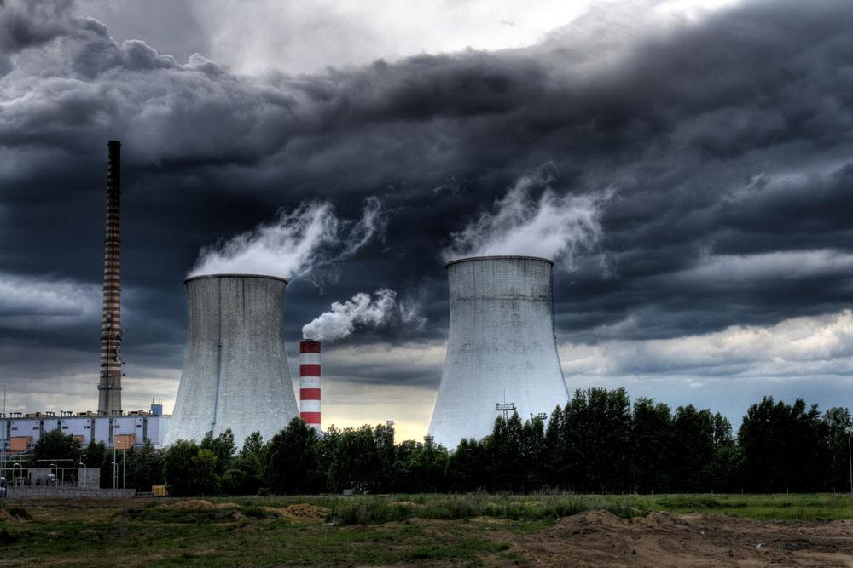
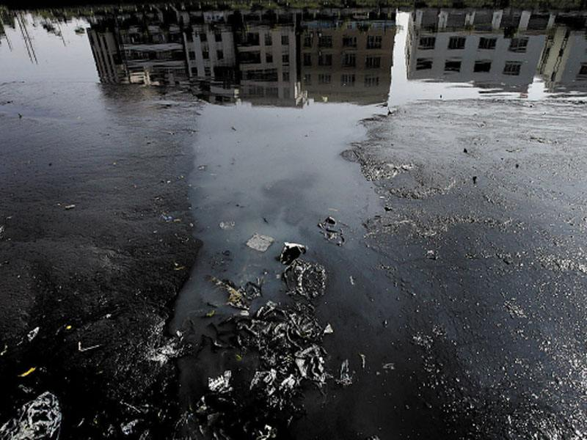



Our Surrounding Area
Industrial Waste Gas
Industrial Waste Water

Slide 3
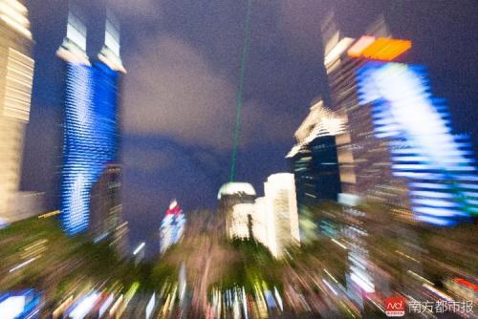
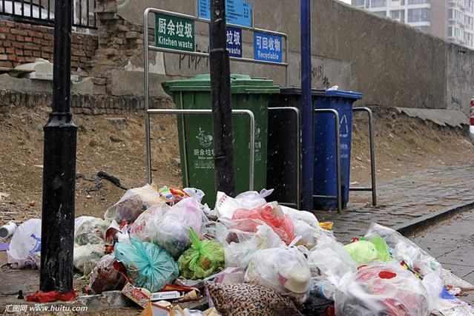
Our Surrounding Area
Light Pollution
Piles of Rubbish

Slide 4
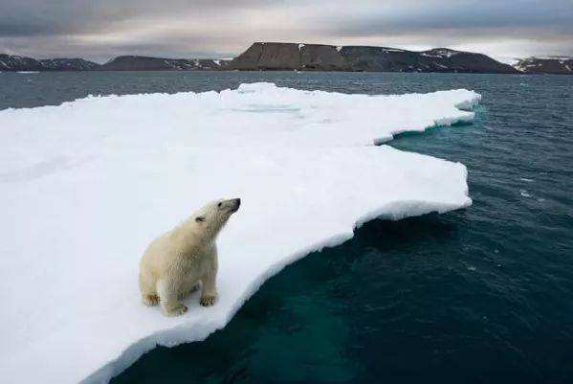
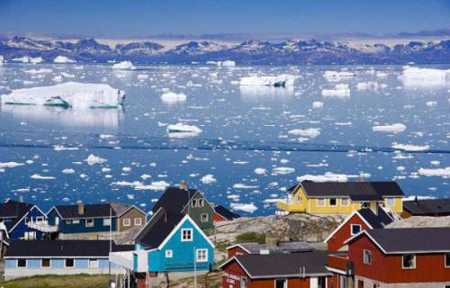
Global Area
Greenhouse Effect
Rise of the Sea Level

Slide 5
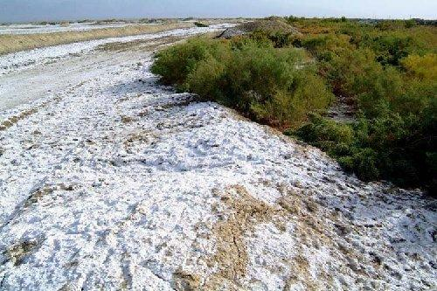
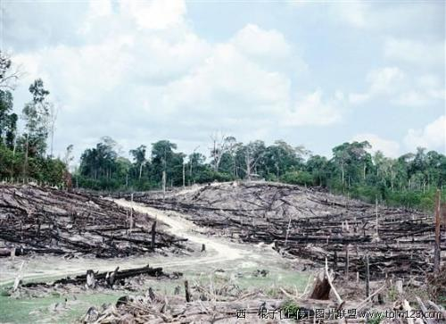
Global Area
Salinization of Soil
Sharp reduction of the rainforests’ area

Slide 6
CONTENTS
01-1. Festivals about Environment
01-2. The Climate Problems
01-3. Garbage Classification
02. Some Solutions

Slide 7
01-1
Environmental Festivals

Slide 8

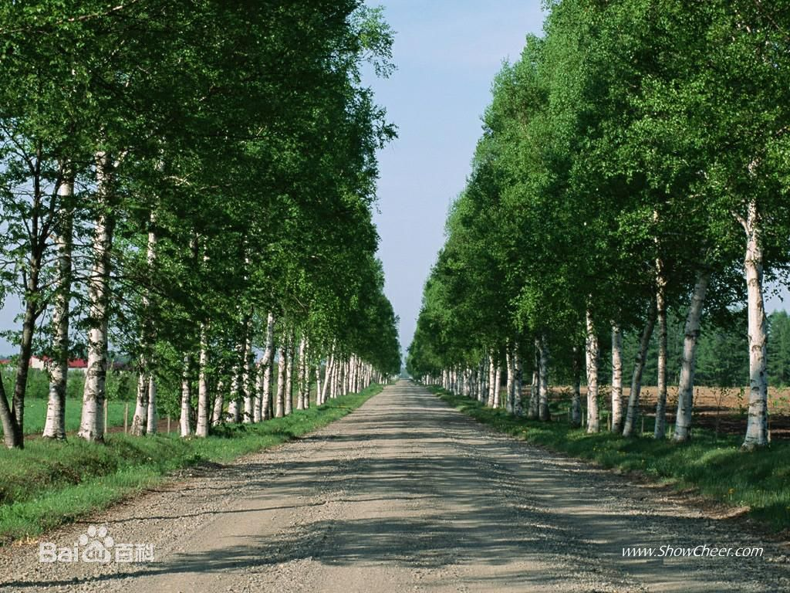



Tree Planting culture
Why we need tree?
expand the forests resources
keep water and soil from floating away
protect farms and adjust the environment

Slide 9




Tree Planting Day
from all over the world
According to the research of the UN, more than 50 countries have established Tree Planting Day.
Asia
Europe
North
America
Middle East
Africa
South
America
Oceania

Slide 10

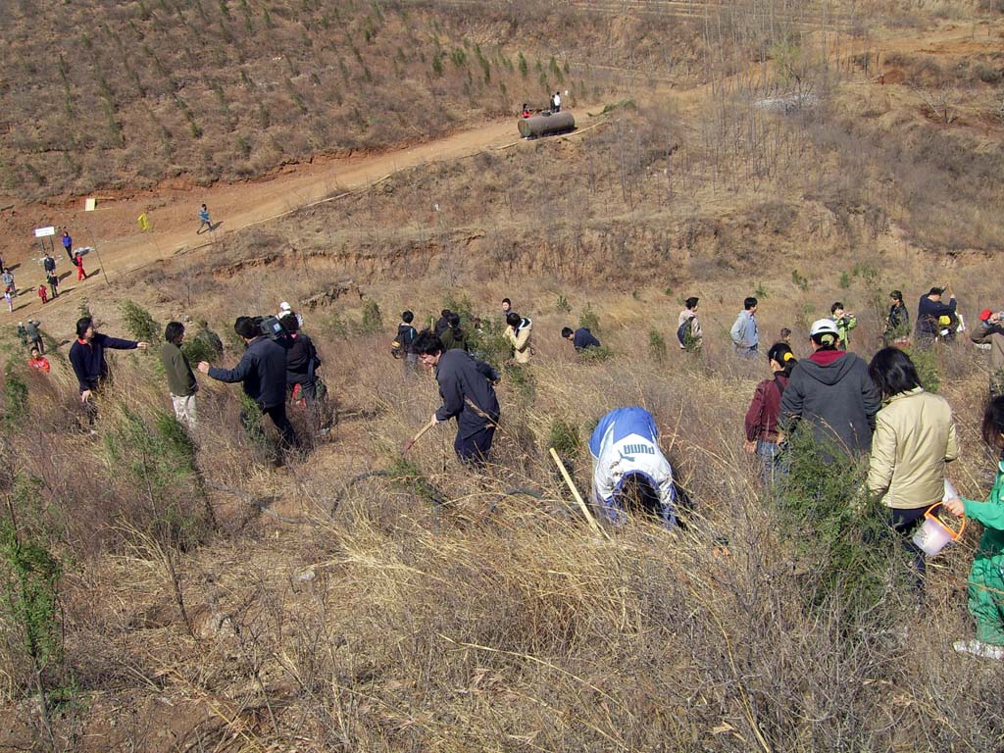

Tree Planting Day
in China
May 12th every year
in honor of Sun Zhongshan
has lasted for 91 years

Slide 11
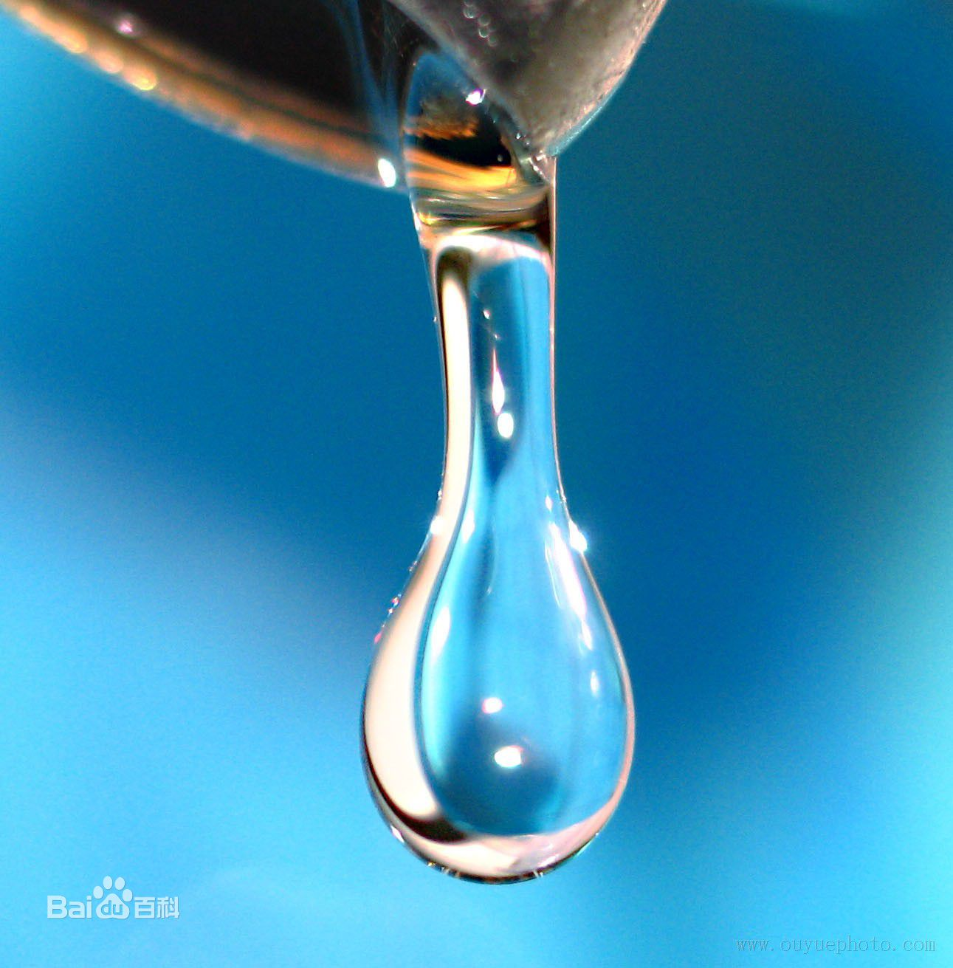


World Water Day
integrated management of water resource
solve the problem of lack
of fresh water
launched in May 22th, 2005

Slide 12
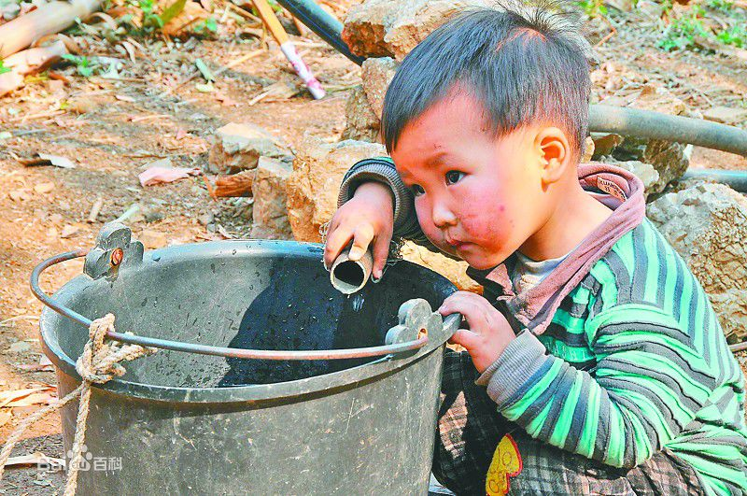
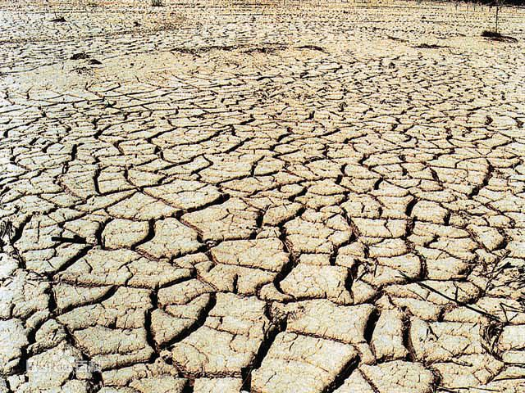
World Water Day
What if we have no water?

Slide 13


Earth Hour
One hour, one earth
launched in 2007 by World Wildlife Fund(WWF)
provoke people’s thought of climate and environment problem through the light-
off in one hour

Slide 14
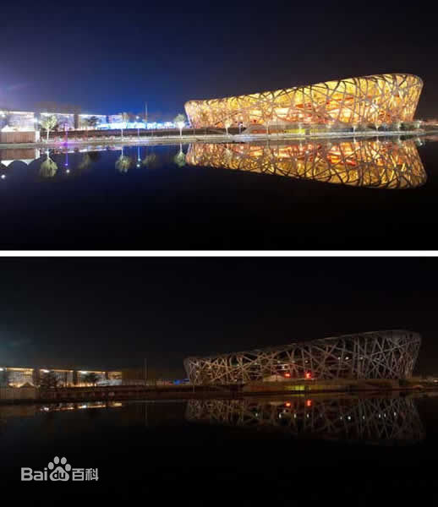
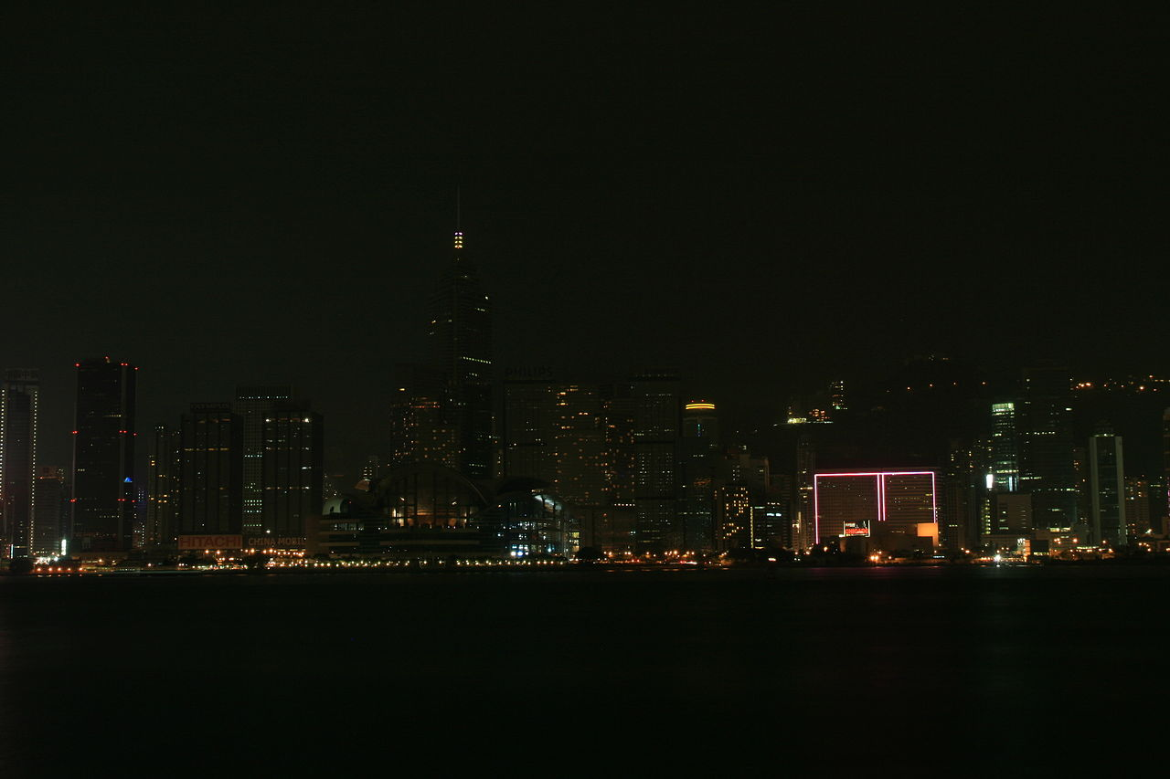
Earth Hour
One hour, one earth

Slide 15
lead a low-carbon lifestyle

Slide 16
01-2
The Climate Problem

Slide 17
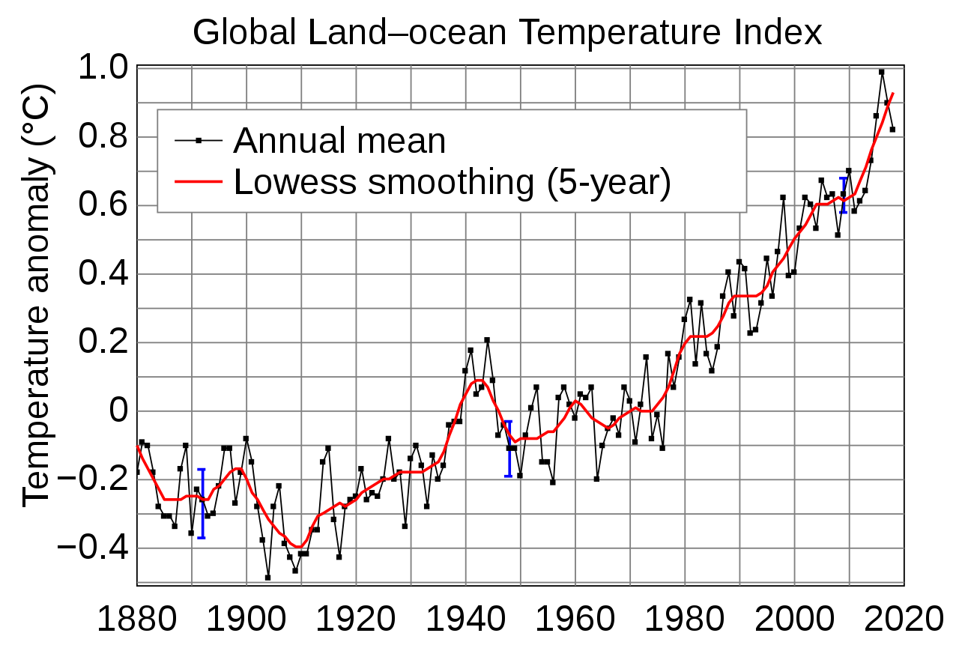








The Global Land-ocean Temperature

Slide 18
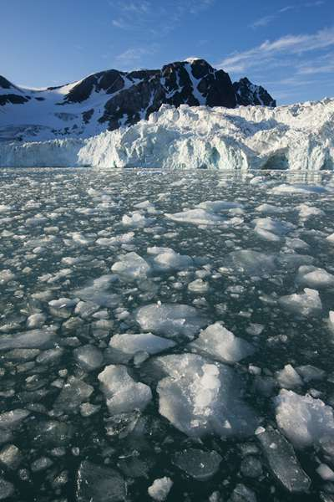
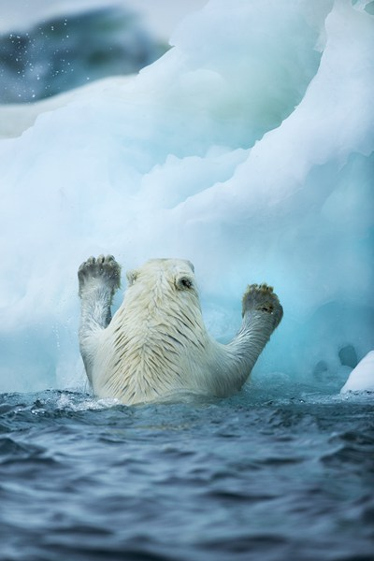

Slide 19
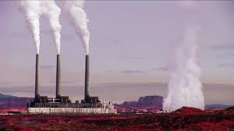
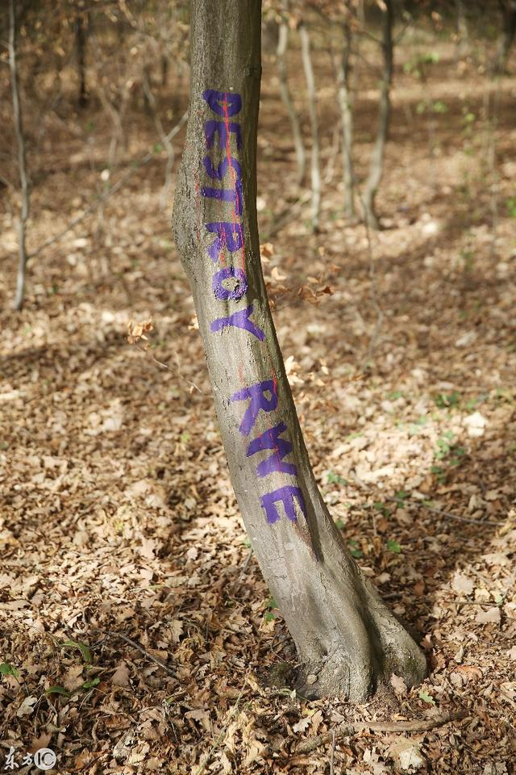



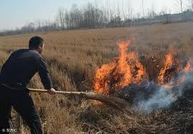
Reasons
The wasted gases
Design inspiration for presentation
Less and less forest
Burning plants

Slide 20


01-3
Garbage classification

Slide 21

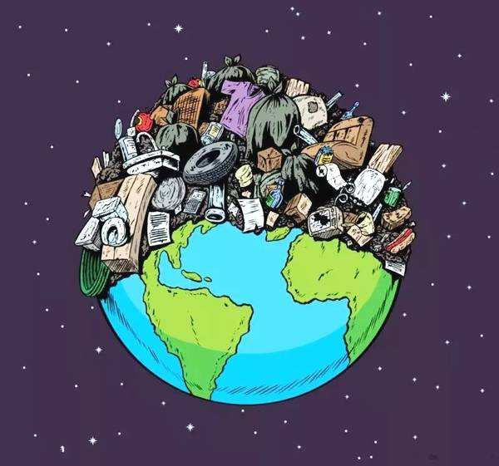
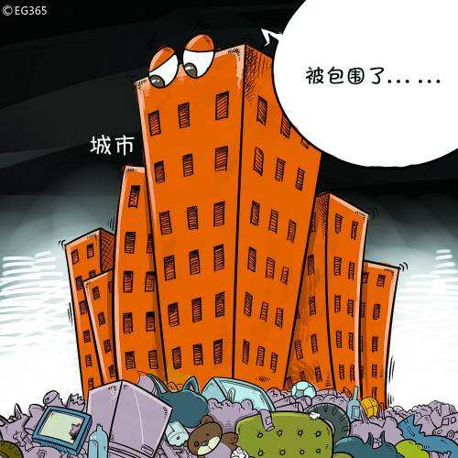
Garbage classification

Slide 22








Garbage classification
Recyclable garbage
Hazardous garbage
paper, metal, plastic,
glass and so on
used batteries and expired drugs.
Garbage
Kitchen waste
Other garbage
leftovers, bones and other food wastes

Slide 23
02
What can we do?

Slide 24

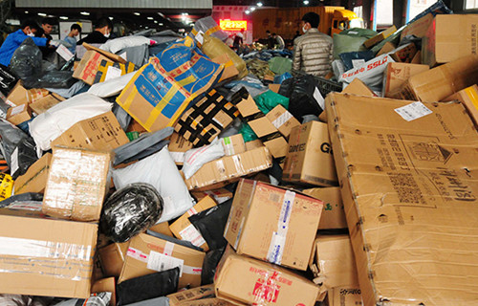
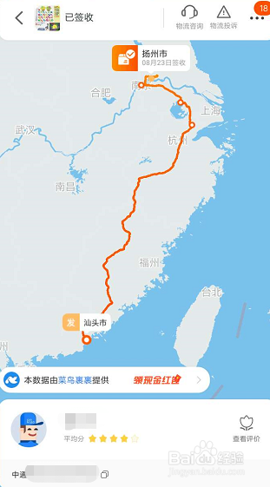
1. Reduce unnecessary online shopping
Outer packing
Transportation

Slide 25
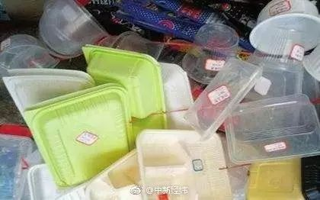
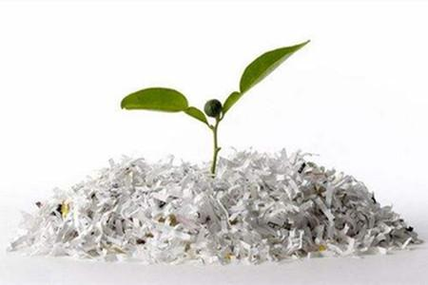
2. Reduce take-out food
White pollution

Slide 26


What to do
3.Use public transportation
5.Save paper
.
Bla bla bla bla bla….
4.Turn off the light

Slide 27
What to do
Awareness
Courage
.

Slide 28
With great power comes great responsibility

Slide 29
THANK YOU
Powerpoint is a complete presentation graphic package it gives you everything you need to produce a professional-looking presentation

